Slide 1
Analyzing the BHL Twitter Network
Grace Costantino
BHL Outreach and
Communication Manager
Using Netlytic to explore the BHL audience and conversations on Twitter
This work made possible by a grant from the Institute of Museum and Library Services (IMLS)

Slide 2
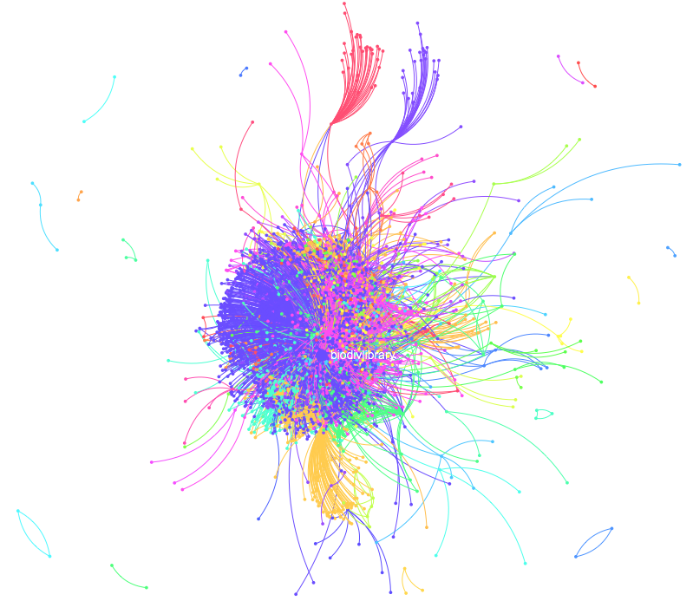
General Analysis
Data analyzed from October 1, 2014 – November 30, 2014.
Content includes Tweets from @BioDivLibrary or tweets including the phrases: “BioDivLibrary”, “#BHLib”, “biodiversitylibrary.org”, or “Biodiversity Heritage Library.”
102,830
Total Tweets Analyzed
6,503
Network Ties,
or Conversations
2,588
Participating Accounts
BHL Twitter Network: Oct. 1-Nov. 30, 2014

Slide 3
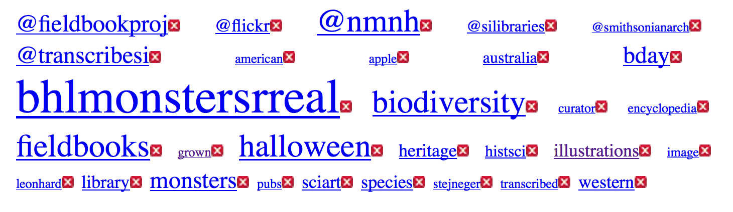
General Text Analysis
Below are presented the top 30 (curated*) words in our network between Oct. 1-Nov. 30, 2014. *Curated: Several of the tops words were meaningless (i.e. “these” and “many”) and were thus removed from the dataset.
BHL Twitter Network: Top 30 Words

Slide 4
General Text Analysis
Takeaways from Top Words:
  “bhlmonstersrreal” showed up 1,268 times in the dataset. This is not surprising, as it was the hashtag used in our very successful Halloween Social Media Campaign. The popularity of this hashtag demonstrates the success of the campaign in our network.
  Several of our BHL partners occur several times in the dataset: “fieldbookproj”, “nmnh”, “silibraries”, “smithsonianarch”, “transcribesi.” This demonstrates that collaboration with our partners increases the reach of our content. Many of these partners are related to The Field Book Project. BHL sends out two tweets per week highlighting FBP content in BHL. “smithsonianarch” and “transcribesi” often retweet these. While the popularity of many of these words relate to these regular tweets, further analysis revealed that those collaborative tweets including links to FBP Flickr or crowdsourcing activities were heavily retweeted. This links to the next point…
    As an aside, NMNH was also among the popular words in the partner category. While we include this handle in many of our tweets, NMNH usually retweets these, which results in many additional retweets. Our most popular relate to dinosaurs and the giant squid. Collaboration with NMNH is thus very beneficial to us, and more dinosaur and marine biodiversity topics might pique the museum’s interest to induce more retweets more frequently.

Slide 5
General Text Analysis
Takeaways from Top Words:
  Images! Four of the top words in the network relate directly to illustrations: “@Flickr”, “illustrations”, “sciart”, and “image.” In total, these four words occurred 1,869 times, more frequently than the individual top word in the network: “bhlmonstersrreal,” which occurred 1,268. This proves that images truly are king to increasing reach and exposure.
  “Australia” occurred 412 times in the network. At first, this might indicate that Australian publications and fauna are very popular among users. However, further analysis revealed that most of these tweets were from a user, @BioStor, which works to divide BHL content into articles and then tweets a link to each article. Thus, what this truly revealed is that @BioStor happened to be working through Australian publications during these months.
  “histsci”. This is a hashtag reaching a community of people interested in the history of science. All of our content relates to this topic, and thus we often employ this hashtag. Thus, at first glance it might appear that we self-fulfilled the popularity of this word. However, further analysis revealed that these tweets are heavily retweeted. Thus, it appears that the use of this hashtag truly does reach a wider audience, resulting in greater reach and popularity. Thus, the hashtag should be continually employed.

Slide 6
General Text Analysis
Takeaways from Top Words:
  Agriculture. Two of the top words inadvertently relate to agriculture: Apple and grown. Investigation of the tweets reveal that they relate to discussions of what was being grown historically, and the variety of historic crops. This suggests that there may be a surprisingly large amount of followers interested in farming, gardening, and agriculture in our network, warranting an increase in these types of tweets.

Slide 7
General Network Analysis
BioDivLibrary network:
  By investigating the BioDivLibrary node within the network, we have an indegree centrality of 2,283 and an outdegree of 405. That means that 2,283 accounts mentioned us in their tweets, while we mentioned 405 accounts. This implies that we have a general broadcasting model in our network, which is not surprising, given that most news outlet feeds demonstrate this model. However, we also want to see our outdegree centrality increase proportionately over time, as this indicates that we are having more conversations, and building greater relationships, within our network. This is a method suggested by the Social Media Lab to grow our network.
  Removing the BioDivLibrary node allows us to investigate some of the other influencers in the network. One is Smithsonian. Analysis of the tweets involved in the Smithsonian node reveal that many of them are from the Monsters Are Real campaign. Smithsonian was one of the biggest contributors to the success of our campaign. Their tweets to our campaign, and retweets of our tweets, produced the most impressions of any account for the campaign. This analysis just further exemplifies how important it is to collaborate with Smithsonian on social media.

Slide 8
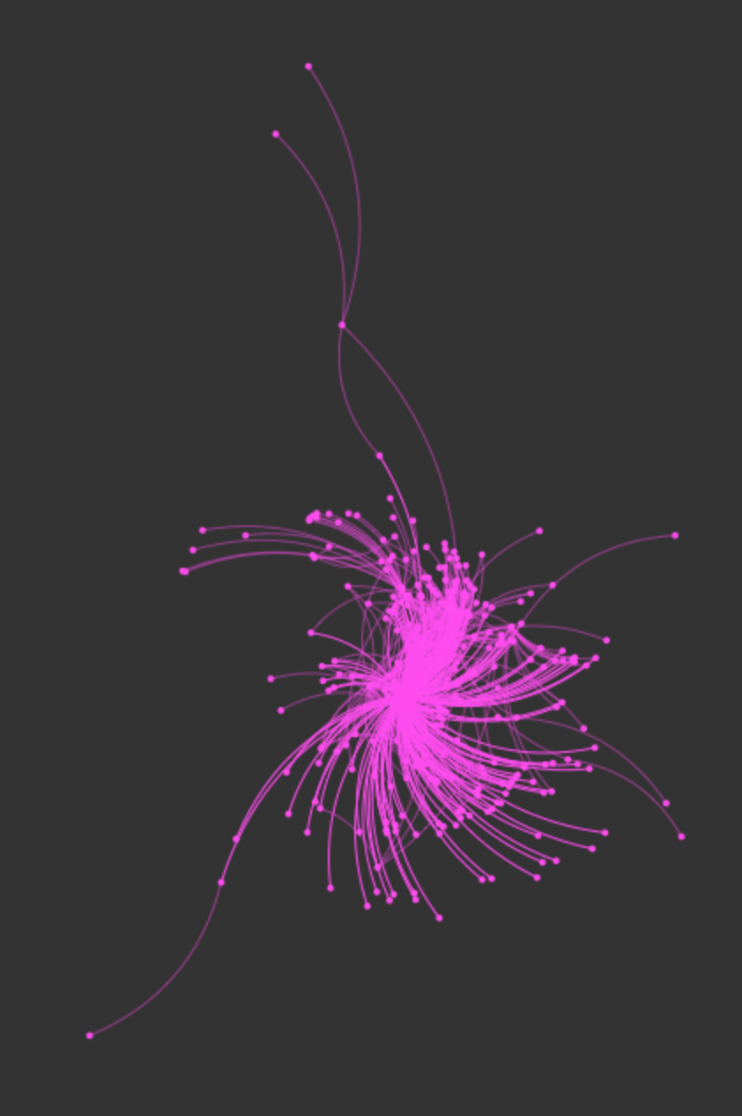
General Network Analysis
BioDivLibrary network
  Smithsonian Libraries. Another cluster within our network radiates out from the @SILibraries node. Investigation of the tweets involved indicate that they relate to a blog post BHL did about a book scanned by SIL, as well as links to our National Fossil Day and Cephalopod Awareness Days Flickr sets. Some of the tweets from SIL are retweets of our tweets, but many are original tweets from SIL. In total, tweets mentioning @SILibraries related to BHL were mentioned by 281 accounts. We have already established through keyword analysis that partner collaboration is important for increasing reach. However, we regularly partner with many of our members on outreach, without the degree of reach achieved through @SILibraries collaboration. One factor is that @SILibraries sends out more tweets than our other members, which might account more some of the increase. Also, it may be that SIL audiences are more interested in our content than other members’ audiences. Whatever the reason, continued collaboration with SIL is important, and increased tweets from other partners about BHL may also result in an increase akin to that seen within the SIL node.
SIL Cluster: Oct. 1-Nov. 30, 2014

Slide 9
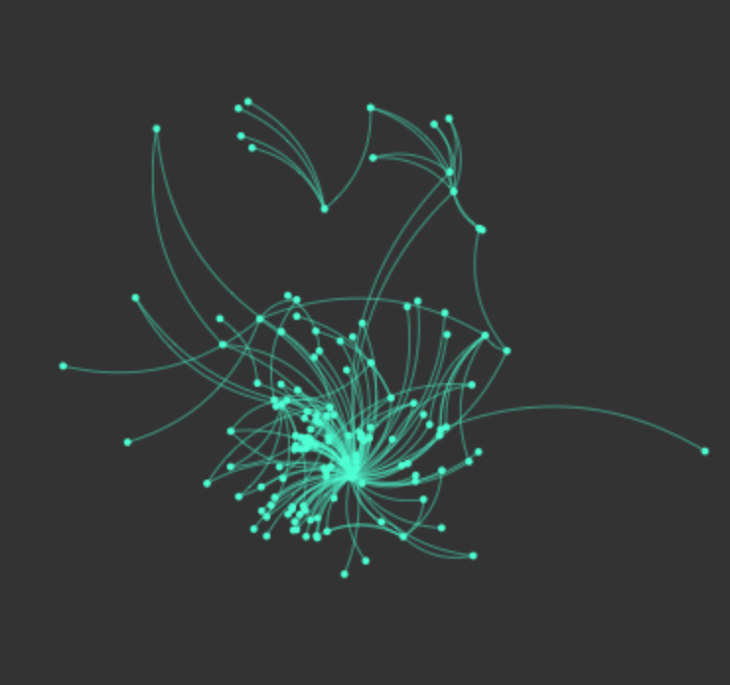
General Network Analysis
BioDivLibrary network
  Flickr. Another cluster within our network radiates out from the @Flickr node. We have already established that images are one of the most popular aspects of our social media outreach. What is interesting in this case is that Flickr itself never once mentioned BHL in a tweet of their own. All of these tweets, which were abundant enough and had a large enough community of participants to generate its own cluster, were from BHL or other members mentioning Flickr in the tweets. We mention Flickr in our tweets both because we know that images are popular and in hopes of Flickr itself retweeting us. While Flickr has not retweeted us yet, this cluster is an indication that we should continue mentioning Flickr in our tweets, and that images truly are king in BHL.
Flickr Cluster: Oct. 1-Nov. 30, 2014

Slide 10
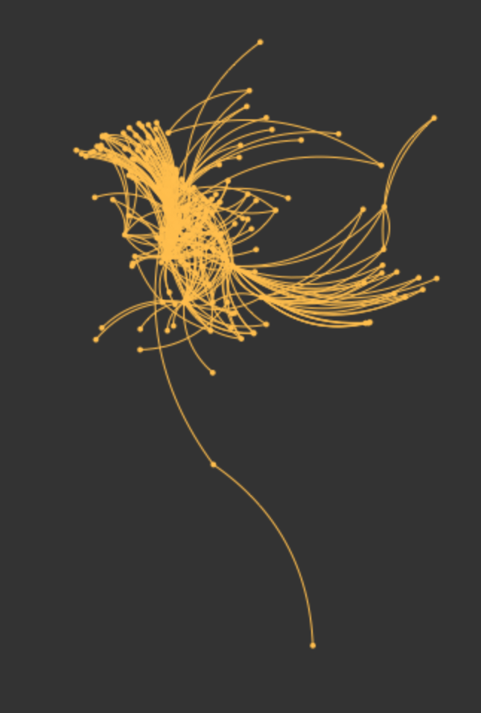
General Network Analysis
BioDivLibrary network: Identifying New Players
  Marine Biodiversity. One of the other clusters in our network involves five central accounts: @OceanPortal, @aquafiles, @monterayaq, @mbari_news, and @saveouroceans. All of these accounts are related to oceans and marine biodiversity. While we ourselves do sent out a fair amount of tweets related to these topics, suggesting that the popularity of this content might be a self-induced phenomena, these tweets are heavily retweeted by these accounts, and the fact that this resulted in an entire cluster centered around marine biodiversity topics indicates that there is a great interest in our community for this topic. Furthermore, these accounts that retweet us reach accounts outside our network, expanding our own audience. Thus, it is definitely worthwhile for us to continue producing marine-themed content.
Marine Biodiversity Cluster: Oct. 1-Nov. 30, 2014

Slide 11
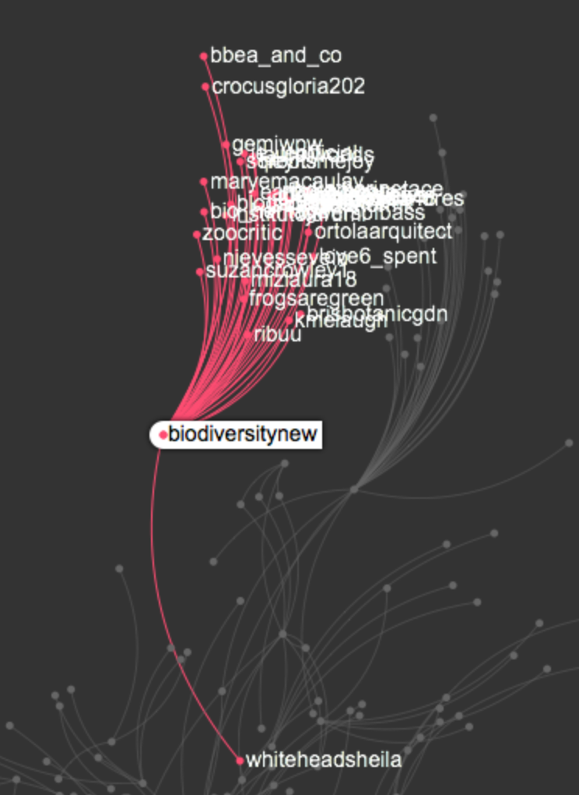
General Network Analysis
BioDivLibrary network: Identifying New Players
  The last cluster remaining is labeled “other.” These are random clusters, without heavy ties to each other, and that also often do not mention our handle; only our resources. Interacting with these nodes is a fantastic way grow our audience and reach new users.
  BiodiversityNew. One network within the “others” cluster radiates around @BiodiversityNew. This is an account that has communicated with us regularly in the past, having interest in our material. They often tweet our resources, but never include our handle or hashtags. They represent a fairly large community within our network, indicating that they are worth reaching out to. Their activities demonstrate interest in Latino Natural History, marine biodiversity, botany, and illustrations.
@BiodiversityNew Node: Oct. 1-Nov. 30, 2014

Slide 12
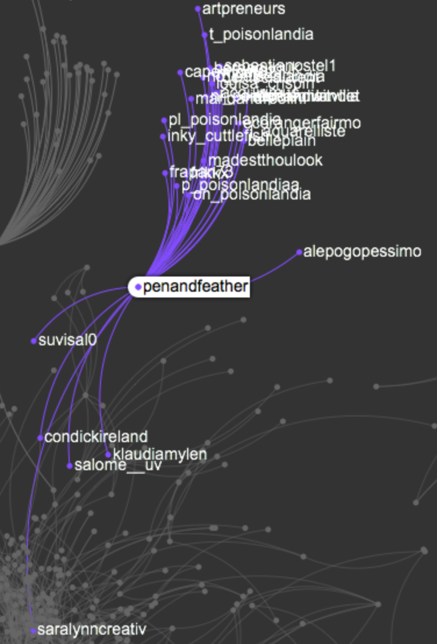
General Network Analysis
BioDivLibrary network: Identifying New Players
  PenandFeather. Another network, that resulted in reaching 33 nodes, only two of which are otherwise active in our network, is @PenandFeather, who featured a BHL book in a blog post they wrote about, not surprisingly, birds. It might be worth tweeting other bird books to PenandFeather in the future, since they obviously like our content and can reach new audiences for us.
@PenandFeather Node: Oct. 1-Nov. 30, 2014

Slide 13
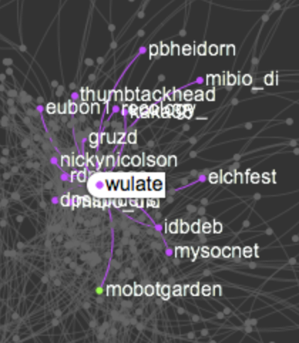
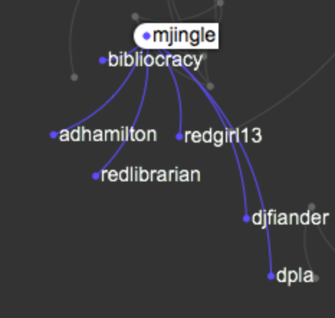
General Network Analysis
BioDivLibrary network: Identifying New Players
  Limited informatics and library discussions. Interestingly, nearly all of the conversations in our network centered around biodiversity, with virtually no library-specific or bioinformatics/technology discussions. While it’s true that we don’t tweet often ourselves about these topics, focusing more on biodiversity and the history of our books, outside players don’t seem to be talking about us in these fields either. Those conversations that are happening are instigated by our own members. So, the question. Should we branch out and try to reach these networks/topics, or stick to our core audience and topic strengths? How will staff limitations affect this decision?
  Small Isolated Nodes. Topics popular among isolated other nodes: Charles Darwin’s Library, agriculture, marine biodiversity, and education.
Limited technical and library-specific
discussion in networks: Oct. 1-Nov. 30, 2014

Slide 14
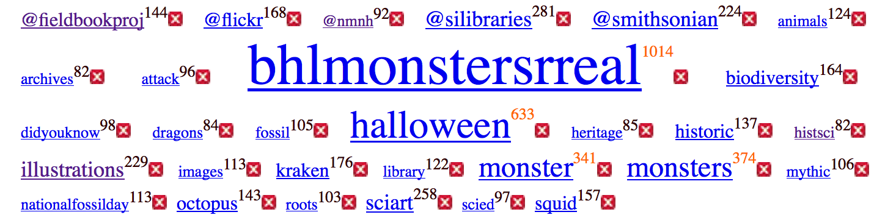
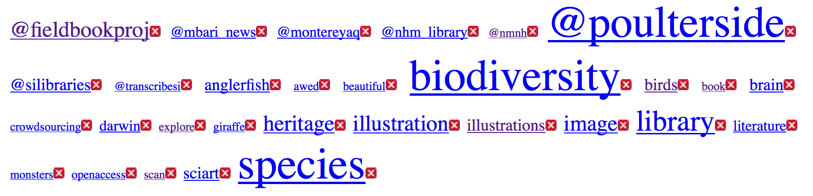
Trend Analysis
October vs November: Top words
  Analysis of the network over the entire available time is useful for capturing overall hot topics and getting an idea of the entire network. However, it is also useful to analyze the network in stages, over different periods of time, to capture trends. Below is a comparison of the top words in tweets for October vs November.
October
November

Slide 15
Trend Analysis
October vs November: Top words
  Consistently Popular: From this analysis, we can see that some topics are consistently popular. Firstly, images. Words related to images are among the top words for both months. Secondly, BHL members are also important consistently, although the particular partners vary somewhat. @FieldBookProj (in part because we tweet out regularly about their content), @SILibraries, and @nmnh are present in both months. However, in October, @smithsonian is also present, whereas in November it is replaced with @nhm_library. The presence of @smithsonian in October is related directly to the Monsters Are Real campaign, which likewise contributed many of the popular words for the month – demonstrating a trend based on a monthly theme: Halloween and the campaign. It is interesting to note, however, that monsters still made it into the top words in November. This probably indicates both that this is a popular topic, and that people are still somewhat sharing fairly recent campaign tweets. It is also plain to see that marine biodiversity remained a consistently popular topic over time.

Slide 16
Trend Analysis
October vs November: Top words
  Trends: In addition to consistently popular content, we can also see trends that are not consistent throughout the months. For instance, there is an obvious bias towards monsters in October (for stated reasons) that does not continue to the same degree in November, and will likely completely die out in future months. Likewise, November saw an emphasis on open access, crowdsourcing, Darwin, and birds, which were absent in October. October also has popular fossil and archival content, probably because of the occurrence of National Fossil Day and Archives Month.
  Take-Aways: Images and Marine Biodiversity are consistently popular and should regularly be employed in our strategy. We are also successful when we collaborate with our members, and this collaboration can take many identities. We also see that capitalizing on trends (like day/month themes) does result in popular content.

Slide 17
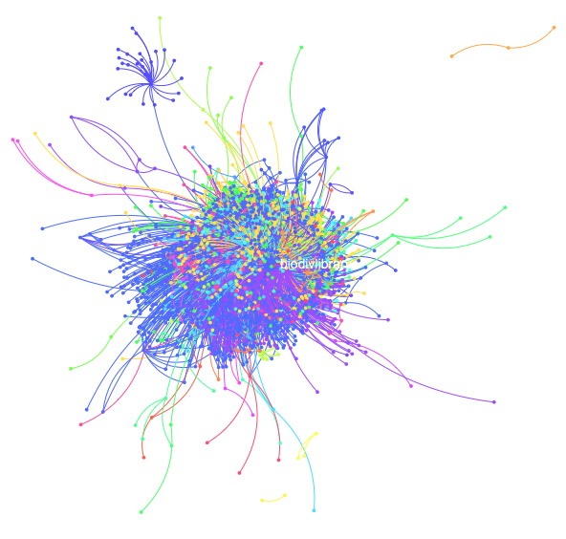
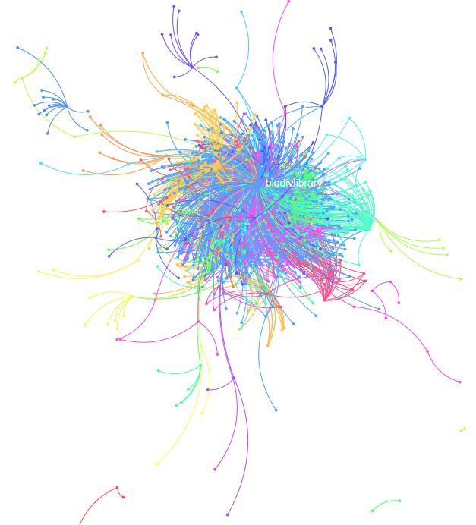
Trends Network Analysis
October vs November network
  Below is a visual comparison of the October vs. November network.
October
November
1,651 participants | 3,907 interactions
898 participants | 2,132 interactions

Slide 18
Trends Network Analysis
October vs November network
  As is obvious from the node and connections comparison, our network was significantly bigger in October vs. November. However, while this would normally be disappointing because it would indicate a downward growth trend, October was the month of our very successful Halloween campaign, which boosted the size of our network significantly. Thus, the conclusions that can be drawn by comparing these two months are limited, as all results are likely to be tainted by the campaign. However, some things to consider:
    In October, @BioDivLibrary was mentioned by 1,462 accounts, while we mentioned 250 accounts. Conversely, in November, @BioDivLibrary was mentioned by 795 accounts while we mentioned 139 accounts.
    In October, the main clusters are centered around @SmithsonianMag, @smithsonian, @Flickr, and marine biodiversity accounts, almost identical to the results seen in the overall comparison. Conversely, in November, the main clusters are centered around @SILibraries, @nhm_library, @mbari_news (a marine-related account), @fieldbookproj, and @kewgardens. One definite difference between October and November: the nodes besides @BioDivLibrary are much smaller and less pronounced in November vs. October. There are very strong, large nodes besides @BioDivLibrary in October (almost all related to the campaign), again demonstrating the strength of our partners’ collaboration in the campaign.

Slide 19
Trends Network Analysis
October vs November network
  In October, the main “other” clusters are radiated around topics related to education, fossils, botany, @calacademy (a BHL partner, resulting from tweets they sent out related to the campaign), and the @BiodiversityNew account (as seen in previous analysis). In fact, the breakdown, participants, and topics for this month look surprisingly similar to that of the entire analysis.
  In November, the main “other” clusters are radiated around topics related to ornithology, botany (through a cluster around @kewgardens from a tweet mentioning recent climate change and seed collecting research the gardens released), the Pen and Feather article, and a popular snail tweet.
Take-Aways
  At this point, it is difficult to draw trends conclusions by comparing these two months, since the Monsters Are Real campaign skews the October network. However, marine biodiversity and tweets radiating around BHL partners (particularly SI-related partners) are consistently seen throughout both months. Similarly, the nodes from October are based more around topics, with several different tweets bringing nodes together into a cluster. Conversely, the November clusters are mostly based around retweets of a popular tweet (produced by BHL), radiating around the account to which the content relates.

Slide 20
Conclusions
At this point, a comparison of month to month networks is not particularly useful, since the October Monsters Are Real campaign significantly skewed the October results. The best take-aways can be drawn from the overall network analysis.
BHL member accounts have a strong influence on our network, particularly SI-related accounts. Strong clusters form around tweets (and retweets) originating from these accounts, and these accounts are top keywords within the analysis. Further, and increased, collaboration should continue in order to keep strong network participation (for example, there was increased member collaboration in October, resulting in larger, stronger clusters).
Images are King. Consistently throughout the months, tweets and content related to images are popular. This topic should be continuously used in future tweets.
Marine Biodiversity is popular. Throughout both months, marine biodiversity content is popular, and is regularly retweeted by outside accounts that help us reach new audiences. Thus, marine content should be regularly shared via BHL.
Obviously, campaigns are very successful for growing the BHL audience. We should continue to plan them around popular themes.
To expand or not? Almost all of the conversations and accounts participating in the BHL network are related to biodiversity science and news. There were minimal conversations about technology/bioinformatics and libraries. Should we try to branch out into these topics to grow our network, or is the fact that these discussions aren’t occurring an indication that the audience is not there for them? How will staffing limitations affect our ability to branch into these discussions?
Few Unknown Conversation. Surprisingly, the analysis did not uncover many conversations happening about BHL that I was not already aware of. Those that were uncovered were between two or very few people, and while these individuals may be able to reach some new audiences not already tapped, impact is likely to be minimal. Thus, a better strategy to increase reach is probably to form stronger relationships with BHL members and biodiversity organizations.

